Slide 1
Salat Assistant
Software development project-I
CSE 2100
Developed by
Md. Masum Billah
1207002
Md. Mehedi Hasan
1207038
Supervised by
Mr. Md. Abdul Awal
Lecturer,
Dept. of Computer Science & Engineering
Khulna University of Engineering & Technology

Slide 2
Objective
Salat Assistant
Become familiarization with Java language and it’s features.
To develop a software project.
To make a source of knowing daily prayer time.
To make a source of knowing Azan alarming signal at the starting time of Namaj.
To make a source of enriching a Computer user knowledge about importance of Salat.

Slide 3
Why “Salat Assistant”?
Salat Assistant
Our project is an assistant based project.
This is based on helping a desktop user.
Our project help him to see daily prayer time.
Our project also help him to know daily Iftar ,Sahry , Sunrise and Sunset time.
This will be abled to create alarm at the starting time Namaj.
This is why we choose this project as our software development project

Slide 4
Features of “Salat Assistant”:
Salat Assistant
Firstly, there contains a mainframe with four options :
Settings
More
About
Help

Slide 5
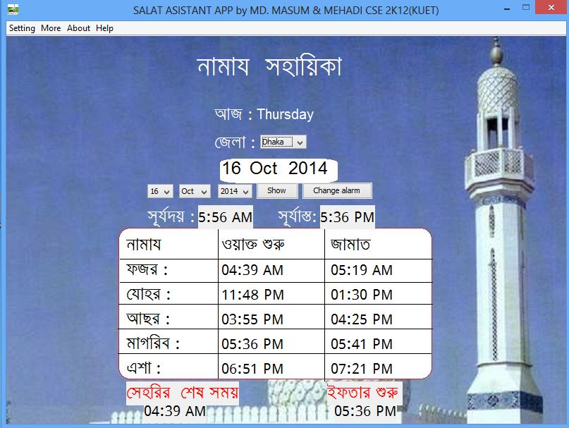
How to work with this project
Salat Assistant

Slide 6
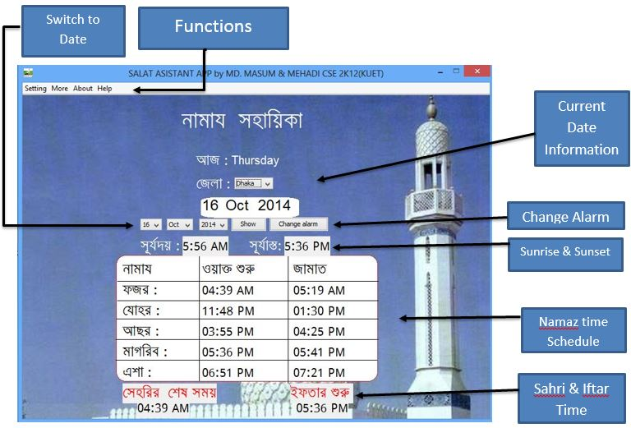
Functionality
Salat Assistant

Slide 7
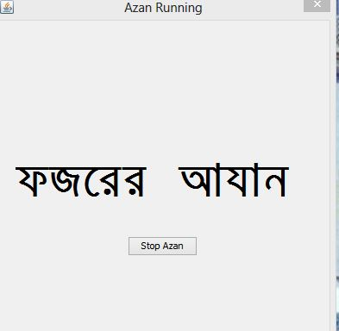
Azan Alarm
Salat Assistant

Slide 8
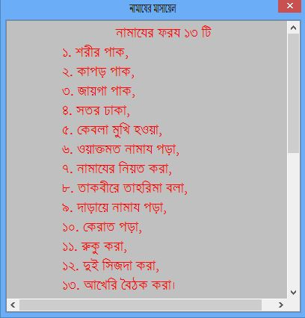
More Features
Salat Assistant

Slide 9
Limitations:
Salat Assistant
Prayer time are set only in Dhaka region .
Only English Calendar are added in this project.
Bangla Font (Siyam Rupali ) should be set up before using this App .
This App are Comfortable for Bengali language learner.
To listen Azan or alarm this App must be opened.
At the time of changing Alarm user can not listen alarm and stop . Alarm and Azan must be .wav file.

Slide 10
Future plan of “Salat Assistant”
Salat Assistant
The Salat Assistant will be updated so that it can be used any region in the world Successfully.
With English calendar Bangla ,Arabic Calendar will be added;
Any language learner will able to use this App comfortably.
Inside Salat Assistant options will be increased.
The Salat Assistant app will be available for mobile.

Slide 11
Conclusion:
Salat Assistant
We have acquired a satisfactory knowledge on java.
We have successfully brought a conclusion to our project “Salat Assistant”.
While doing so many times faced a lot of difficulties. We overcame these obstacles by taking help from our supervisor as well as our seniors.
The project may be small but it inspires us to do something bigger in future.

Slide 12
System.out.println( “Thanks to all”);
Salat Assistant

